Slide 1

LTI system (2-D)
$$\frac{dx_{1}}{dt}=k_{1}X_{0}−k_{2}x$$
↓
$$x\left(t\right)=\frac{X_{0}k_{1}}{k_{2}}(1−e^{−k_{2}t})+x_{0}e^{−k_{2}t}$$
↓
$$\frac{dx}{dt}=Ax→det\left(A−λI\right)=0 \\ → Solutions: c_{i}e^{λ_{i}t} \\ →Solutions of\frac{dδx}{dt}=Aδx$$
Notes:
Let’s say we have a first order system. The time domain solution to this system is below (solving the ODE).
The first part of the eq is the steady state term and the second part is the transient term, so any dynamics of the system is determined by the second part.
This part also corresponds to the solution when there is no input to the system, which is a homogeneous solution.
From linear algebra we know that we can find the solution to a homogeneous solution in the form of ce^lamb*t, where lambdas are eigws.
This is essentially an eigenvalue problem.
Lastly, in a linearlized system, the solutions correspond to the solutions in the change of perturbation in x.

Slide 2

LTI System (in laplace)
Input: $X\left(s\right)={\left(sI−A\right)}^{−1}x_{0}+{\left(sI−A\right)}^{−1}BU\left(s\right)$ Output/Input: $G\left(s\right)=\frac{Y\left(s\right)}{X(s)}=\frac{Y(s)}{{\left(sI−A\right)}^{−1}x_{0}+{\left(sI−A\right)}^{−1}BU\left(s\right)}$
Roots of denominator: Poles → Eigenvalues
Notes:
The Laplace transform of an LTI system with non-zero initial conditions is given as this.
If you look, the (sI-A) looks the same as the (A-lamdI) for calculating the homogeneous solution, other than a sign flip.
So, if you write it out the transform as a transfer function, the expansion of the denominators will tell us the eigenvalues.
The roots of the denominator are called the poles, and these poles are the eigenvalues of the homogeneous solution.

Slide 3
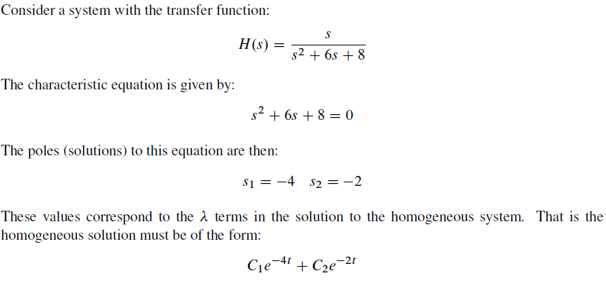
Notes:
For example:

Slide 4
Internal vs. External Stability
x(t) p
u(t)
y(t)
Internal: System returns to a steady-state after one or more of the state variables have been perturbed. → Are the state variables x(t) stable?
External: A finite change to an input of the system elicits a finite change to the internal state of the system. → Are the outputs y(t) stable?

Slide 5
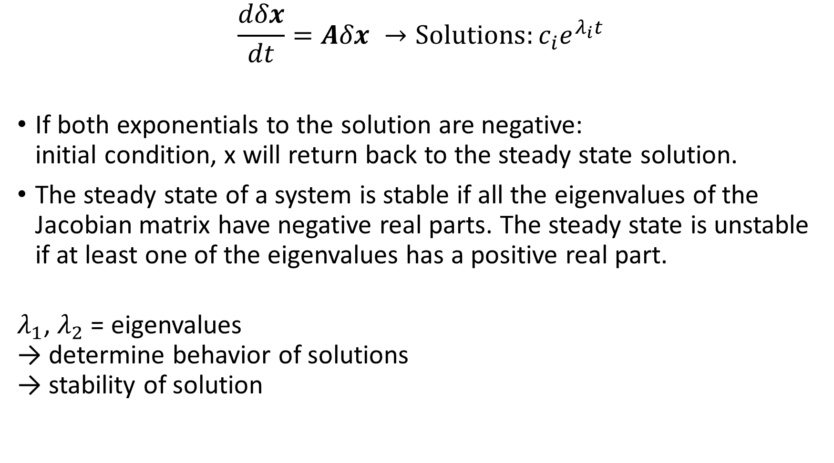
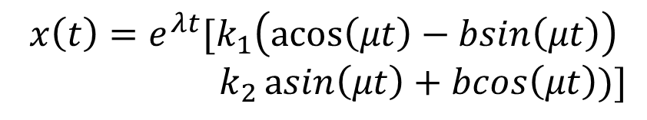
$$\frac{dδx}{dt}=Aδx →Solutions:c_{i}e^{λ_{i}t}$$
If both exponentials to the solution are negative: initial condition, x will return back to the steady state solution.
The steady state of a system is stable if all the eigenvalues of the Jacobian matrix have negative real parts. The steady state is unstable if at least one of the eigenvalues has a positive real part.
$λ_{1}$, $λ_{2}$ = eigenvalues → determine behavior of solutions → stability of solution
$$x\left(t\right)=e^{λt}[k_{1}\left(\operatorname{acos}\left(μt\right)−bsin\left(μt\right)\right)$$ $k_{2}\operatorname{asin}\left(μt\right)+bcos\left(μt\right))]$
Notes:
Since we are looking at the perturbation in x, we need to look at the eigenvalues of the jacobian.
We can also get a complex eigenvalue solution as well: In that case we will have a periodic time-based solution.

Slide 6
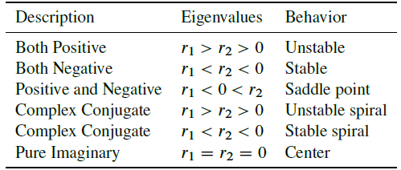
Stability Types

Slide 7
Notes:
Jacobian: -2, 0, -0.5, -1 Stable System. You can see that eigw are negative and the time plot converges to steady state.
1, -1, 0, 2 Unstable system: Positive eigw, Goes apart.
1 -2 0 -1 Saddle: eigw opposite signs, goes apart unless on the saddle, specific initial values.
-0.5 -1 1 -1 Spiral stable: eigw are complex but real parts are negative, so converges.
0 1 -1 0.5 Spiral unstable: eigw are complex, real parts positive, so diverges.
0 2 -2 0

